Slide 1
HW 2 Presentation – Stock Market Forecasting Using Computational Intelligence: A Survey
Ryan Patton

Slide 2
Introduction
Stock market: an open market in which equity securities or shares of company are traded publically to raise money for research and development, introducing new products, entry into new markets, financial growth, acquiring competitors, etc…
Share: part ownership of a company
Stock market approaches for forecasting:
Fundamental analysis (most common): investors focus on various metrics that reflect the health of the company before purchasing its stock (favored by long-term investors)
Technical analysis (second most common): investors study various metrics like turnover, expenses, annual and quarterly reports, profit and loss, income statements, assets and liabilities, balance-sheet, etc… (favored by short-term investors)
Traditional statistical methods: autoregressive moving average (ARMA), exponential smoothing (ES), autoregressive integrated moving average (ARIMA), autoregressive conditional hetereoskedasticity (ARCH), and generalized autoregressive conditional heteroskedasticity (GARCH) – predict future stock prices on the basis of past stock prices
Soft computing methods: Artificial Neural Networks (ANNs) and Support Vector Machines (SVMs) – improves on traditional statistical methods to deal with highly noisy, non-linear, complex, dynamic, nonparametric, and chaotic data.

Slide 3
Previous Related Work
Neural and Neuro-Fuzzy Techniques utilize five key perspectives:
The stock market surveyed
The input variables investigated in each model
Techniques and parameters utilized to build the prediction model
Different model comparisons
The performance measures used to measure accuracy of each model
Proposal of various text mining approaches (more modern than 2016 techniques):
Feature selection methods
Feature representation approach
News source utilized
Classification techniques applied
The number of categories or target classes
The directional accuracy
Evolutionary Computation approaches proposed for solving financial problems:
Genetic Programming (GP)
Learning Classifier Systems (LCSs)
Genetic Algorithm (GA)
Multi-Objective Evolutionary Algorithms (MOEAs)
Co-evolutionary optimization scheme
Competent evolutionary algorithm
ANNs previewed in stock market prediction, for text mining, in both international and US markets.

Slide 4
Basic Terminology & Concepts
Stock market (explained earlier): publicly owned market for selling and buying the shares of a company that issues them at an agreed price
Trading: selling and buying shares
Stock (explained earlier): type of security which is a financial instrument that has some monetary value and can be purchased or traded, collection of shares
Share: portion of ownership of a company
Private securities: only selected individuals can invest in this stock
Public securities: anyone can invest in this stock
Investment rules in India enforced by Securities and Exchange Board of India (SEBI)
List companies: companies allowed to trade in stock market
Stock exchange: place where shares of firm are traded
Initial Public Offering (IPO): directly supplies company shares to stock exchange
Stock exchange examples: NYSE, NASDAQ, BSE, NSE
Stock index: a statistical measure of performance of group of companies, representing performance of the market
Stock index examples: DJIA, S&P 500, NASDAQ Composite, S&P BSE Sensex, Nifty 50

Slide 5
Basic Terminology & Concepts (Continued)
Stocks classified by sector (healthcare, IT, telecom, etc…)
Stock Market Forecasting: process of predicting the future prices of the stock market on the basis of previous historical data
Time Series: set of observations generally collected at successive points in time
Fundamental Analysis: performed on the basis of economic data of companies and it involves forecasting stock markets using economic data of companies that is published at regular periods of time for example price to earnings ratio (P/E) ratio, turnover of company, profit and loss, annual and quarterly report, assets and liabilities, balance sheets, and income statements
Technical Analysis: accords to time series data and it involves forecasting stock markets using charts or other technical indicators
Computational Intelligence: collection of techniques that are applied to imitate the human thinking power in order to deal with complex problems of the real world
ANNs: massively paralleled distributed systems inspired by the human brain
Fuzzy Logic: an expansion of classical set theory; a method of representing human knowledge that is imprecise in nature in a particular area of application and in reasoning with that knowledge to make useful decisions or inferences
Genetic Algorithm: derivative-free, parallel, adaptive, and dynamic optimization method inspired by biological evolution

Slide 6
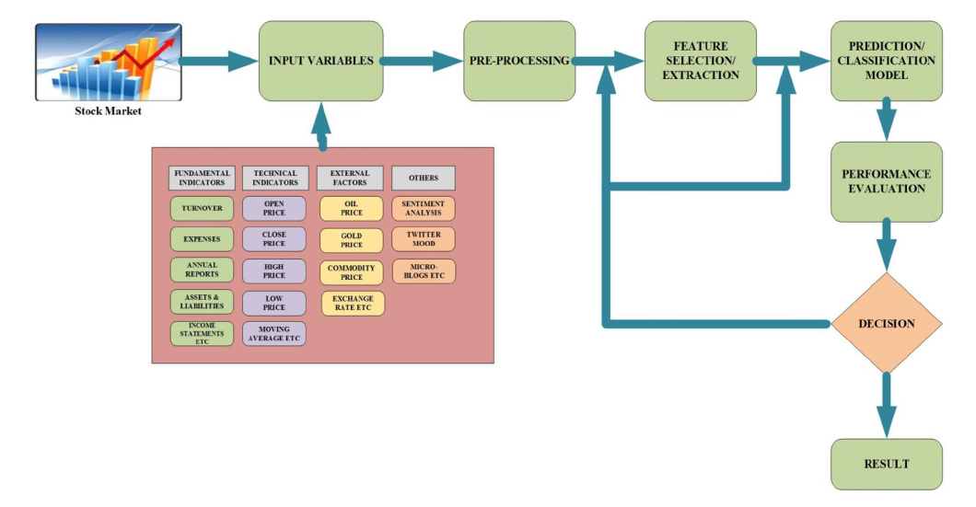
Forecasting Work Flow
Systematic approach for forecasting the stock market, operational steps:
Selection of input variables
Data pre-processing
Feature selection and extraction
Training using prediction/classification model
Evaluating proposed model performance

Slide 7
Stock Markets Surveyed
Model DAX index of German stock market traded in Frankfurt stock exchange
TAIEX stock index of Taiwan for case study
Predicting NIKKEI 225 index of Tokyo stock exchange
ISE national index of Turkey stock exchange
BSE Sensex and Nifty 50 indices of Indian stock market
DJIA S&P 500, IDIX, and SPDR S&P 500 indices of NYSE and NASDAQ for most common studied indices among studies surveyed
Petrobras stock PETR4, traded in BM&FBOVESPA
Tehran stock exchange forecasting
Major indices of China stock market forecasting
ASX200 index of Australian stock market
Mexican stock exchange time series of Mexico stock market
Trends in SET50 index of Thailand stock exchange
Modeling the BIST100 index of Turkish stock market
Forecasting the Korean stock market
FTSE index of London stock market forecasting
South Central European country, Croatia’s Zagreb stock exchange
Athens stock exchange (ASE) general index of Greece
Individual stocks instead of stock markets (showing the ability of networks to predict major stocks of US)
16 companies in Tokyo
IBM, Dell, IT sector, British airways, Ryanair
Petroleum and Chemical Corp. of Chine’s stock market
Predicting stock prices of varying number of companies instead of stock indices in China

Slide 8
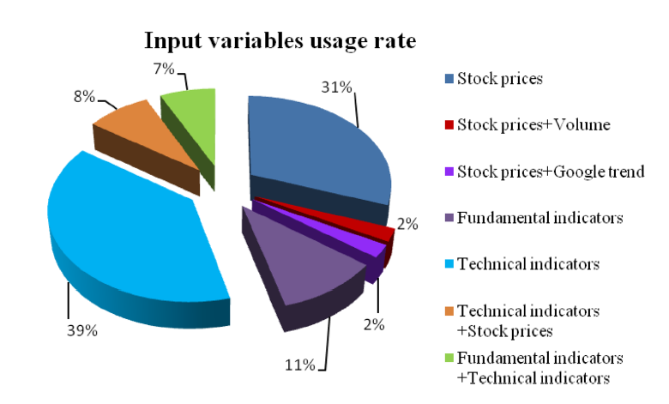
Input Variables
Two most common types of features used for predicting stock markets:
Fundamental indicators
Technical indicators
First stage in stock market forecasting is selecting the input variables

Slide 9
Data Pre-Processing Methods
Quality of data is the main factor because accuracy and reliability of prediction models depend upon the quality of the data – most important step
Must account for noise, outliers, and unwanted anomalies
Must cover range of inputs that the network will be used for
Researchers used various normalization methods for transforming from one scale to another:
Min-max normalization
Three statistical based information criteria (Bayesion information criteria, Schwarz Bayesian information criteria, and Akaike information criteria) – to account for lags in time
Integrated Component Analysis (ICA) used as input of a backpropagation neural network (BPN) to create a forecasting model
Some used time series with logarithmic data smoothing to remove noise
A hybrid forecasting model, Wavelet De-noising-based Back Propagation (WDBP) was use to remove noise and get better accuracy by using in conjunction with Wavelet Transform (WT)
Mutual Information (MI) function was utilized to identify the time delay constant, and false nearest neighbors (FNN) was used to find minimum embedding dimensions so they could then use the best time delay
Principal component analysis (PCA), kernel-based principal component analysis (KPCA), and fuzzy robust principal component analysis (FRPCA) with ANNs were used to handle missing values, mismatched samples, and outliers
Wavelets helped identify clusters
Sigmoid function helped normalize data
Locally weighted scatterplot smoothing (LOWESS) detected and removed outliers in time series which show abnormal variations of the stock price

Slide 10
Feature Selection & Extraction
Feature selection: choosing important features and discarding irrelevant ones
Feature extraction: involves mapping from original higher dimensional feature space to lower dimensional feature set, which is more informative with respect to the task performed
Unique approach: hybrid feature selection combining both filter and wrapper methods to forecast stock market trend in two stages
First stage: F-score statistics as filter to determine optimum subset from given set of features
Second stage: applied SVM as wrapper prediction to generate set of key features
Other methods aiding feature selection/extraction:
Non-linear independent component analysis (NLICA)
Cross correlation feature selection
Linear correlation
Regression relief
Rank correlation
Random forest
Proximal support vector machine (PSVM) classifier
Stepwise regression analysis (SRA)
K-means clustering
Nonlinear independent component analysis (NLICA)
Principal component analysis (PCA)
Feeds into wavelet neural network (WNN)

Slide 11
Forecasting Models
Challenging task in time series and CI domain
Depends on the choice of task performed by authors, i.e. whether they want to forecast trend (up or down) in the stock market
Modeled as classification task or prediction of numeric value
Paper focused on core CI approaches (described on following slides)
Neural networks
Genetic algorithms
Fuzzy logic
Other evolutionary computing approaches

Slide 12
Artificial Neural Networks (ANNs)
One of the most efficient techniques to forecast stock market as it does not comprise complex formulas compared to traditional linear and non-linear models
Grown in popularity in the last decade
Able to handle data that are characterized by nonlinearity, high-frequency polynomial components, and discontinuity
Methods used by authors:
ISE National 100 predicted by upward/downward trend using ANNs and SVMs (ANN wins)
Feed-forward NN predicts next day DJIA index close price
ANN foresees 1 day ahead of closing stock price of Indian stock market
Backpropagation algorithm trains three layer neural networks
Multilayer perceptron (MLP) develops automatic trading system for Australian stock market
Uses 4 fundamental indicators: return on equity (ROE), book value, dividend payout ratio, and price to earnings ratio (P/E)
Feedforward neural network (FFNN) combined with Bayesian regularization to foresee movement in stock market
Ensemble learning to combine a rule based evolutionary technique and ANN to take buy or sell decisions in stock trading
Performance assessment of different NN models for stock market index prediction
Used MLP, DAN2, hybrid NN combining GARCH and EGARCH with MLP
Computational efficient functional link artificial neural network (CEFLANN) – sets rules
MANY MORE

Slide 13
Fuzzy Logic
Used for modeling and forecasting stock price time series
Interesting approach: integrating genetic fuzzy system (GFS) and ANNs to create an intelligent system for stock price prediction
Other methods used by authors:
Takagi-Sugeno-Kang (TSK) for stock market forecasting
Neuro-Fuzzy inference system applying fuzzy C-mean clustering used for stock market forecasting
Adaptive network based fuzzy inference system (ANFIS) for predicting stock market return
Fuzzy rule bases for forecasting stock faith (high or low) – strength for buying or selling
Type-2 fuzzy system for stock price prediction by using fundamental and technical indicators
Type-2 neuro-fuzzy system to model stock price predictions
Four-layer fuzzy multiagent system (FMAS) to create a hybrid intelligent system that combines the multiple intelligent agents to predict the next day stock price
Adaptive neuro-fuzzy inference system (ANFIS) for predicting close price of stock market 5 days in advance, individually for each day
Self-evolving recurrent fuzzy inference system (SERFIS) for enhancing the prediction power of traditional neuro-fuzzy systems
Neuro fuzzy inference system (ANFIS) and integrated non-linear feature selection (INFS) to predict stock prices
Differential fuzzy time series logic to forecast trends in stock market data
Mamdani fuzzy system and technical indicators for generating trading signals
Interval type-2 fuzzy logic system (IT2FLS) to forecast stock indices
Fuzzy logic and combination of visibility graphs to link predictions to accuracy
Fuzzy time series models and rough set rule induction to forecast stock indices
Stock price time series prediction models based on WT with ANFIS
MANY MORE

Slide 14
Genetic Algorithms (GAs)
Used in literature to enhance the forecasting accuracy of prediction models
Methods used by authors:
GA based paradigm to construct classification model that finds trading rules from technical indicators
Associative classifier by proposing GA approach for generating sell and buy signals
Hybrid forecasting model combining autoregressive integrated moving average (ARIMA) with genetic programming (GP) to foresee non-linear time series
GAs to tune connection weights of partially connected NNs to forecast trends in stock market
Paradigm for stock selection problem using support vector regression (SVR) and GAs
GA-based associative classification rules (ACRs) for discovering trading rules from technical indicators which generate buy or sell signals
Markov decision processes and GAs to create a decision support system for best stock investment strategy
Graph-based evolutionary algorithm, namely genetic network programming (GNP), for extracting significant number of stock trading rules from technical indicators
Intelligent hybrid trading system to find trading rules by applying rough set analysis and a GA
Automated investing method based on technical analysis, feature selection, outlier filtering, genetic programming (GP), and ensemble to take three investments decisions such as to buy or to sell or to hold shares of a company
MANY MORE

Slide 15
Hybrid Prediction Model
Combine core CI approaches to enhance the accuracy of prediction models by combining advantages of individual approaches and avoiding drawbacks of certain individual techniques
Recommended to be more efficient in improving the accuracy of individual based learners
Next 4 slides cover various hybrid prediction models

Slide 16
Hybrid ANN
Methods used:
Hybrid bat neural network multi agent system (BNNMAS) to forecast stock price
Two stage fusion approaches using Support Vector Regression (SVR) in initial stage and SVR/Random Forest (RF) used in the last stage of fusion
Infinite impulse response (IIR) based dynamic neural network to forecast stock price index from 1 day before to 30 days in advance of distinct stocks
Radial basis functional neural network (RBFNN) for training the stock market historical data of stock exchange
Hybrid method of particle swarm optimization (PSO) and ensemble neural network with fuzzy aggregation from complex time series forecasting
Comparisons of differential evolution algorithm (DE) and particle swarm optimization (PSO) in optimizing the parameters of feedforward neural network (FFNN) utilized to predict daily stock prices
Backpropagation neural network (BPNN) and improved bacterial chemotaxis optimization (IBCO) to establish a forecasting model than can predict stock index
Artificial neural prediction approach by combining stepwise regression analysis (SRA), radial basis functional network (RBFNN) and recursive based particle swarm optimization (RPSO)
Combining wavelet transform (WT), recurrent neural network (RNN), and artificial bee colony (ABC) algorithm to tune RNN weights and biases
Improved sine cosine algorithm (ISCA) to tune parameters of back-propagation neural network (BPNN) for forecasting the direction of opening stock price
7 MORE METHODS DESCRIBED

Slide 17
Hybrid Genetic Algorithm (GA)
Methods used:
Three population based stochastic optimization techniques such as bat algorithm (BA), genetic algorithm (GA), particle swarm optimization (PSO), and two gradient-based algorithm viz
Combining Hidden Markov Model (HMM), genetic algorithm (GA), and ANN for forecasting stock market behavior
Hybrid intelligent model combining standard NN with modified GA to deal with stock price time series forecasting
Evolutionary NN incorporating GA with feedforward NN for stock exchange forecasting
Integrating self-organized map (SOM) NN and genetic programming (GP) to forecast stock price
Hybrid model GA-BPNN by applying GA to obtain optimized parameters for BPNN for prediction of stock indices
Combining ANN and GA for trend prediction of stock index
Correlation examination between technical indicators and stock market by proposing a hybrid model which combines capabilities of harmony search (HS) and genetic algorithm (GA) with ANN
Hybrid model composed of 2 linear models viz. autoregressive moving average (ARMA) model and exponential smoothing (ES) and one non-linear model, namely recurrent neural network (RNN)
Hybrid ANN based on metaheuristic optimization algorithms namely cuckoo search (CS), improved cuckoo search (ICS), GA, improved cuckoo search GA (ICSGA), and PSO to predict stock indices and model comparisons
3 MORE METHODS DESCRIBED

Slide 18
Hybrid Fuzzy Logic
Methods used:
Hybrid approach by assembling fuzzy C-means (FCM), ANN, and data envelopment analysis (DEA) for forecasting financial performance of various corporations
Fuzzy time series prediction model based on integration of single multiplicative neuron model (SMNN), PSO, and M-estimators to improve prediction accuracy of stock price time series affected by outliers
Novel hybrid method by aggregating Takagi-Sugeno (TS) fuzzy rule-based technique with SVR technique for identifying turning points of trading signals in stock market
Hybrid fuzzy time series combining the capability of fuzzy c-means clustering (FCM), single multiplicative neuron model (SMNM), and PSO to predict stock market index
Integration of fuzzy time series (FTS) and GA to forecast stock market
Hybrid model using adaptive network-based fuzzy inference system (ANFIS) and swarm intelligence optimization technique, namely fruit fly optimization algorithm (FOA) to predict stock market volatility
Interpretable neuro-fuzzy approach based on Pearson’s correlation coefficient, subtractive clustering, constrained optimization and rule based reduction techniques to predict stock price with an aim to deal with interpretable-accuracy trade-off

Slide 19
Other Evolutionary Hybrid Models
Methods used:
Hybrid intelligent system by combining a nature-inspired optimization technique, namely artificial bee colony (ABC) with K-nearest neighbor (KNN) algorithm and its variant called adaptive classification and nearest neighbor (A-k-NN)
Model based on chaotic mapping, SVR, and firefly algorithm to predict share prices
Hybrid technique based on SVR and modified firefly algorithm (MFA) to solve stock market forecasting

Slide 20
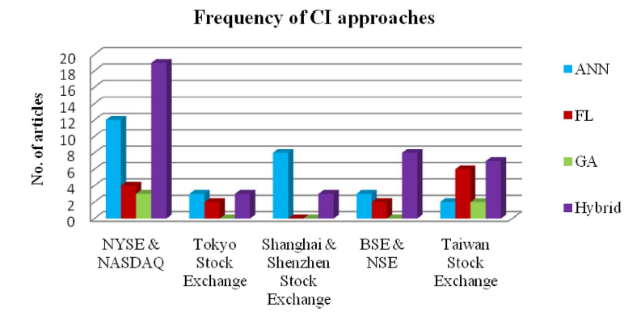
Performance Evaluation
Evaluation metrics to be used depend upon the type of problem being modeled (i.e. whether it’s a model classification problem or regression problem)
In Tokyo and Shanghai, ANNs are most frequently used for forecasting share market indices

Slide 21
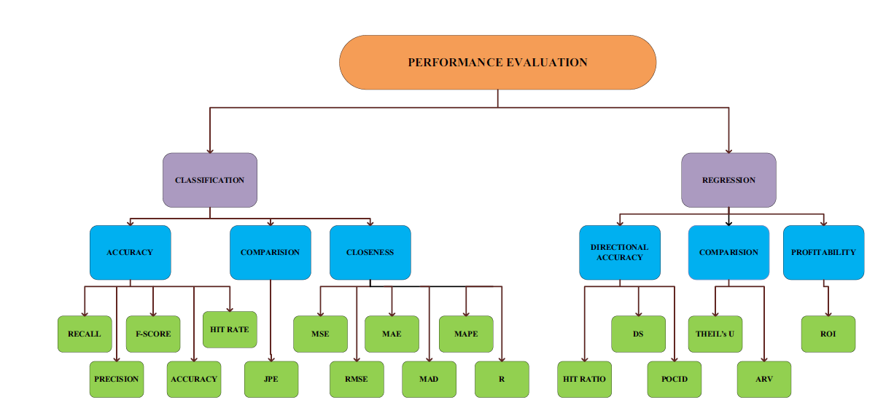
Taxonomy of Most Frequently Used Evaluation Metrics

Slide 22
Proposed Work
Hybrid models are more accurate than traditional approaches
Stages of proposed work:
Obtain historical stock market data.
Compute technical indicators using real stock market data
Pre-process the dataset to normalize the data in the [0, 1] range
Apply feature extraction techniques to determine the technical indicators that most influence stock price and reduce dimensionality
Develop a hybrid forecasting model to forecast stock market by utilizing ANNs
Apply evolutionary optimization techniques to tune parameters of proposed model for improving accuracy
Evaluate the prediction capability of proposed model using various performance metrics
Presenting the trading signal or stock price predicted value

Slide 23
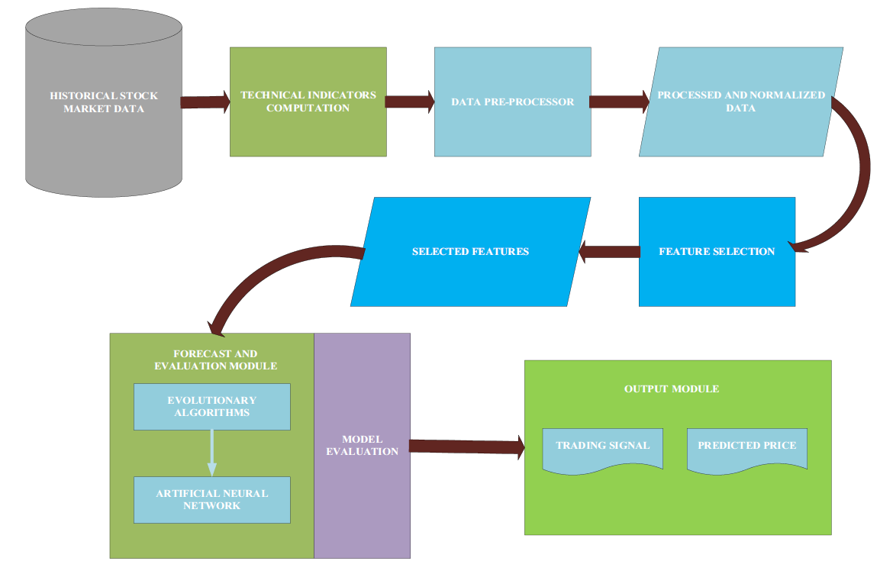
Proposed Work Flow

Slide 24
Conclusion
Four major findings:
Technical indicators play a prominent role in stock market forecasting
Identifying pre-processing and feature selection techniques help improve accuracy
CI approaches can be effectively used to solve stock market forecasting problems with high accuracy, with hybrids being the most effective
Performance metrics are not unique, supporting the use of different combinations of metrics by different authors from their data sources
Authors assert that to their knowledge, they are the first survey to present these sources of data in the stock market, covering a wide variety of international markets

Slide 25
References
[1] Kumar, G., Jain, S., & Singh, U. P. (2020). Stock Market Forecasting Using Computational Intelligence: A Survey. Archives of Computational Methods in Engineering, 1-34. doi:10.1007/s11831-020-09413-5

Slide 26
Questions?

